Slide 1

Sets in Python

Slide 2
Agenda
To discuss sets in python

Slide 3
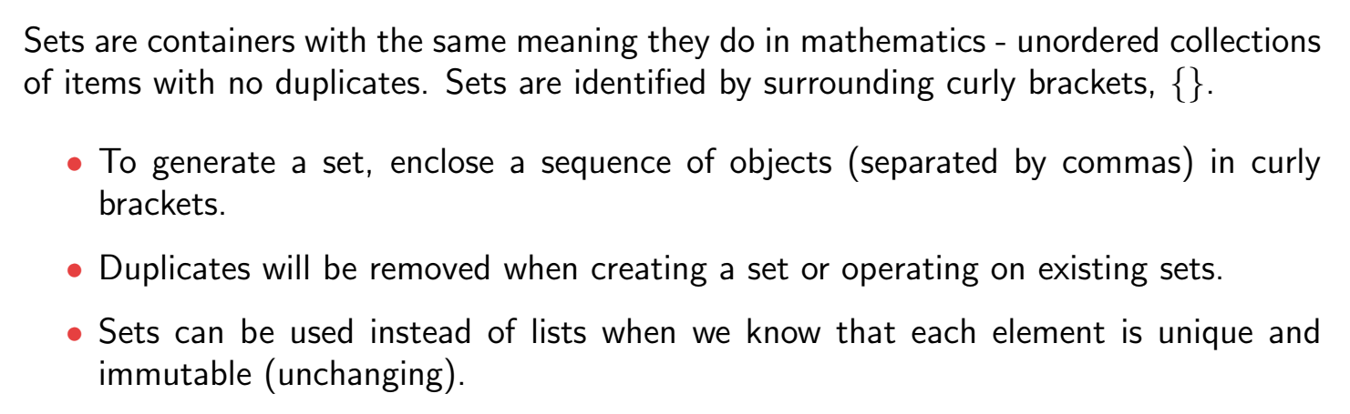
Sets

Slide 4
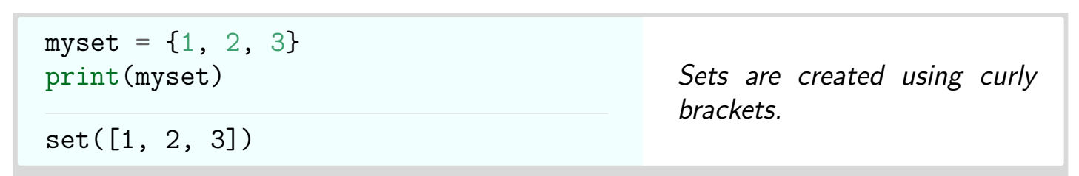
Sets

Slide 5
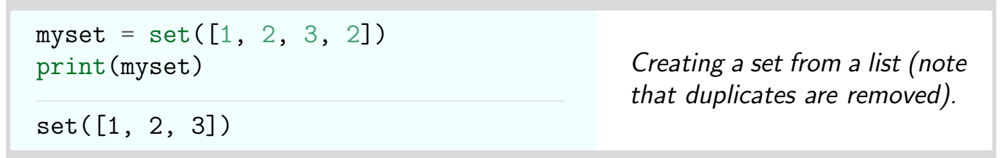
Sets

Slide 6
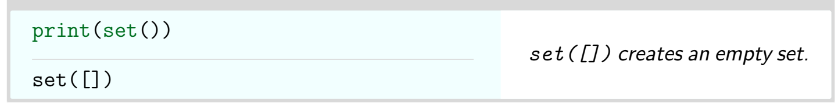
Sets

Slide 7
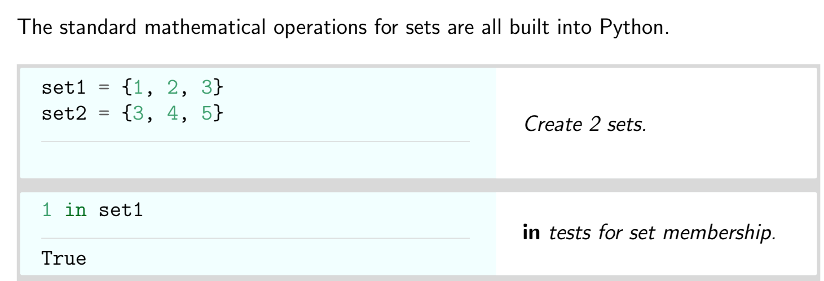
Sets

Slide 8
summary
You have learnt sets in python.

Slide 9
Thank You

